Slide 1
Comparisons of Modern GWA Algorithms on Arabidopsis thaliana Dataset
Julian Liber and Philip Ankley

Slide 2
Introduction
Genome Wide Association Studies (GWAS) aim to identify single nucleotide polymorphisms (SNPs) associated with phenotypes
SNPs may indicate which genes are causal in disease or traits
Provides targets for drugs and markers for breeding

Slide 3
Justification
9 algorithms for GWA were published in 2017
7 primary identification
2 summary algorithms
Need to provide authors with a review of current methods

Slide 4
Project Goals
Address important characteristics to users
Accessibility of code
Ease of use
Computation time
Accuracy
Provide thorough review of algorithms

Slide 5
Dataset
Atwell et al. 2010 dataset of phenotypic profiles for 199 Arabidopsis thaliana genotypes and 216,130 SNPs
Similar linkage disequilibrium to humans
High SNP density - 1 SNP per ~500 bp
107 phenotypes for multiple comparisons
Established as useful testing dataset for GWA studies
Used flowering time traits, due to well known loci

Slide 6
Hierarchical Association (HA)-Coefficient
Applies hierarchical ranking to identify casual SNPs
Produces a value known as the HA-coefficient
Higher value corresponds to more significant
Script included as supplementary materials, written in R
Needed to be modified to accept real data, based on simulated data
Fast, under 5 minutes

Slide 7
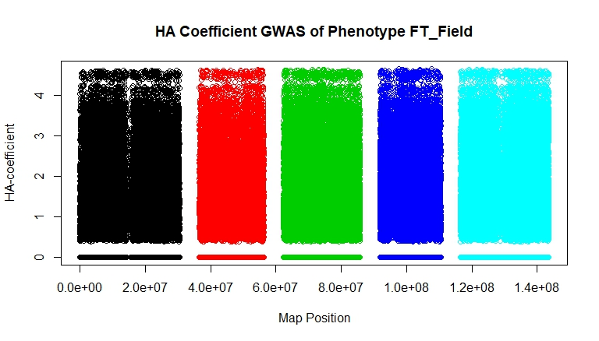
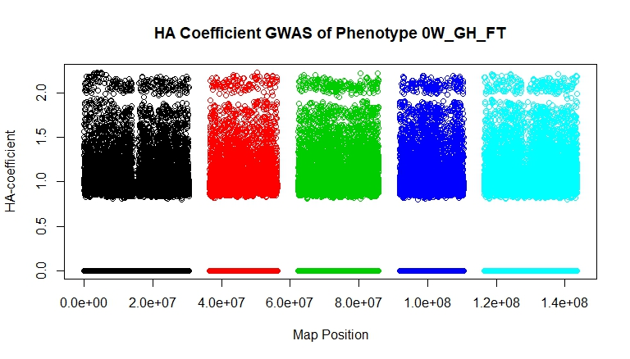
HA-Coefficient Results
Appears ineffective at identifying important SNPs in traits known to have related SNPs

Slide 8
Accuracy Measurement Issues
SNPs often did not line up to known, annotated sites
Probable cause is changes in known chromosome sizes, mapping map data incorrect
Very difficult to verify associated genes without accurate positions

Slide 9
ISIS EM-BLASSO
Iterative modified-Sure Independence Screening EM-Bayesian LASSO
Uses correlation to reduce markers, then uses variable selection, and finally EM Bayesian LASSO algorithm
Downloaded from rdrr source code, but available in CRAN
Data input was very difficult to figure out with poor documentation
Necessary code modification
Moderate speed, at about 15 minutes

Slide 10
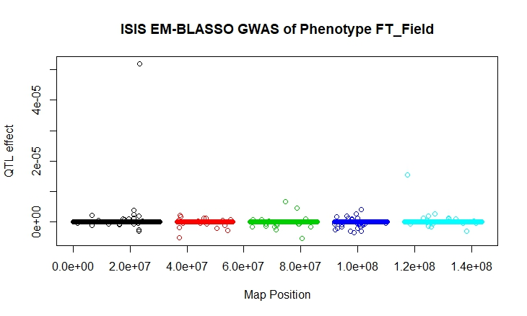
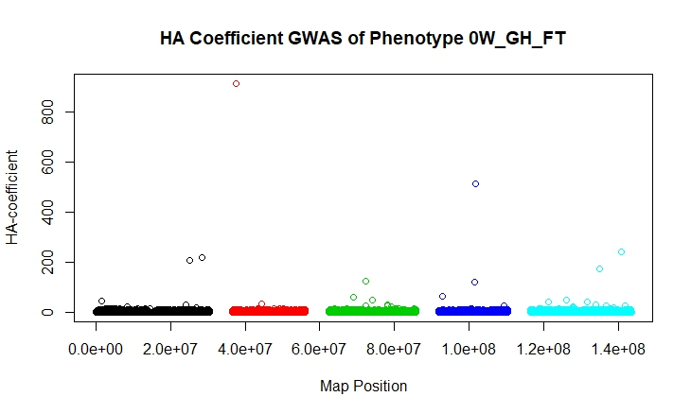
ISIS EM-BLASSO Results
Appears more effective at identifying specific SNPs

Slide 11
pLARmEB
Polygenic-background-control based least angle regression plus empirical Bayes
Contained in same package as previous, but source code also downloaded from rdrr
Same input data requirements as previous, similar modification and poor documentation
Unable to complete run after 18 hours
No data or errors output

Slide 12
Other algorithms
Coal-Miner
Had good documentation , easily downloadable, and seemed usable, but required Unix-only packages
BGTools
Easily downloadable, but not installable in R
MUSE
Proposed algorithm without published scripts
LLR
Downloadable, but written in Matlab

Slide 13
What did we learn?
Lots of R - debugging, dataframes, GWAS data types, plotting
Challenges of working with large genotypic datasets
Various methods for obtaining code
Necessary GWAS data – genotypic, phenotypic, kinship, population structure

Slide 14
What would we change?
Get HPCC access to allow for running code we cannot run on our computers due to time, licenses, or operating system
Work on understanding data structures before manipulating algorithms
Find an expert

Slide 15
References
Atwell S, Huang YS, Vilhjálmsson BJ, Willems G, Horton M, Li Y, Meng D, Platt A, Tarone AM, Hu TT, Jiang R. Genome-wide association study of 107 phenotypes in Arabidopsis thaliana inbred lines. Nature. 2010 Jun;465(7298):627.
Duan W, Zhao Y, Wei Y, Yang S, Bai J, Shen S, Du M, Huang L, Hu Z, Chen F. A fast algorithm for Bayesian multi-locus model in genome-wide association studies. Molecular Genetics and Genomics. 2017 Aug 1;292(4):923-34.
He D, Parida L. MUSE: A MULTI-LOCUS SAMPLING-BASED EPISTASIS ALGORITHM FOR QUANTITATIVE GENETIC TRAIT PREDICTION. InPACIFIC SYMPOSIUM ON BIOCOMPUTING 2017 2017 (pp. 426-437).
Hejase HA, Vande Pol N, Bonito GM, Edger PP, Liu KJ. Coal-Miner: a coalescent-based method for GWA studies of quantitative traits with complex evolutionary origins. bioRxiv. 2017 Jan 1:132951.
Kim B. Hierarchical Association Coefficient Algorithm: New Method for Genome-Wide Association Study. Evolutionary Bioinformatics. 2017 Aug 22;13:1176934317713004. Kooperberg C, LeBlanc M, Obenchain V. Risk prediction using genome‐wide association studies. Genetic epidemiology. 2010 Nov 1;34(7):643-52.
Liu J, Wan X, Wang C, Yang C, Zhou X, Yang C. LLR: a latent low-rank approach to colocalizing genetic risk variants in multiple GWAS. Bioinformatics. 2017 Aug 14;33(24):3878-86.
Tamba CL, Ni YL, Zhang YM. Iterative sure independence screening EM-Bayesian LASSO algorithm for multi-locus genome-wide association studies. PLoS computational biology. 2017 Jan 31;13(1):e1005357.
Zhang J, Feng JY, Ni YL, Wen YJ, Niu Y, Tamba CL, Yue C, Song Q, Zhang YM. pLARmEB: integration of least angle regression with empirical Bayes for multilocus genome-wide association studies. Heredity. 2017 Jun;118(6):517.

